Slide 1





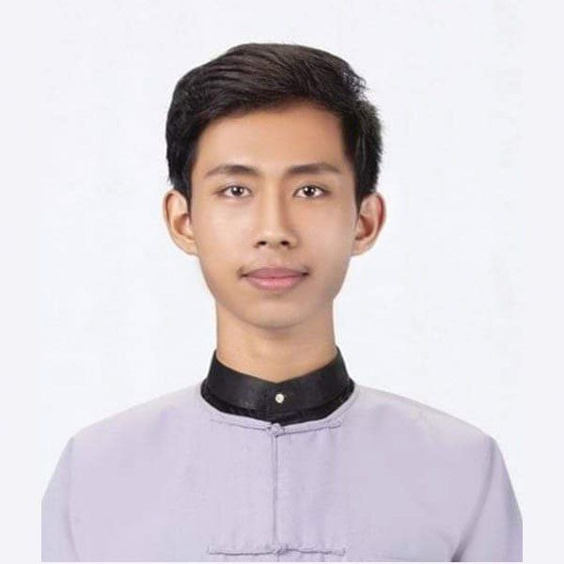


ALL ABOUT ME!

Slide 2


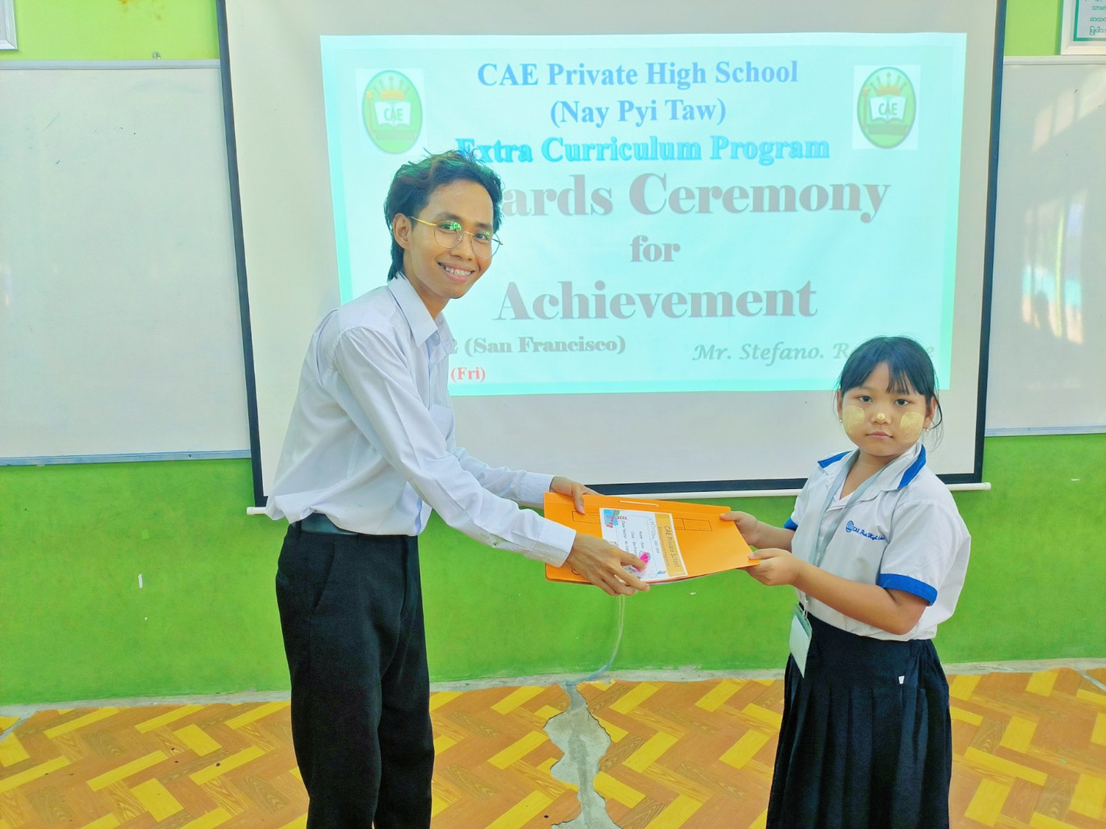


HELLO!
My name is Stefano. Ra Shane. My favorite color is blue. I love English class and anything that has to do with art!

Slide 3

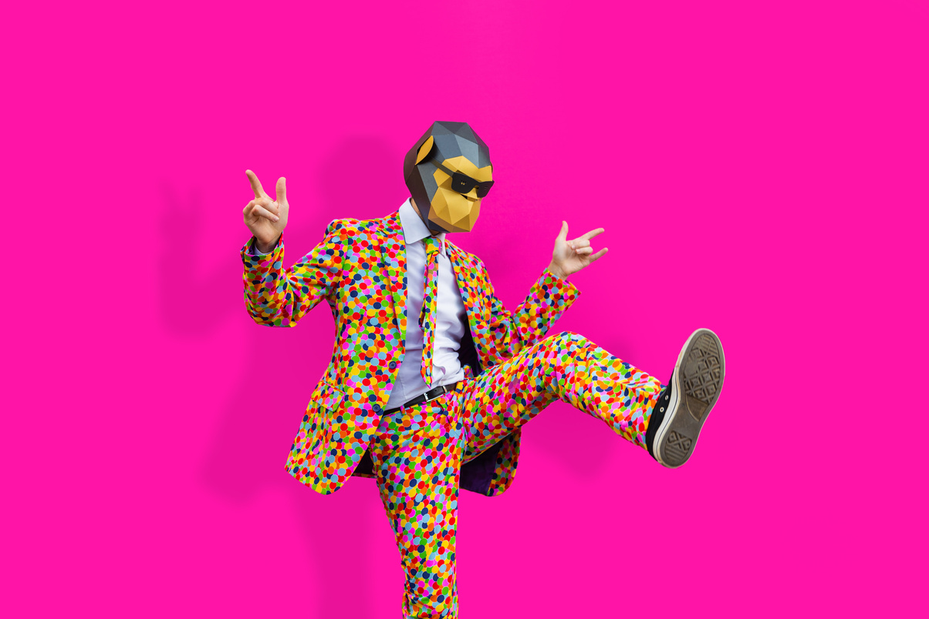
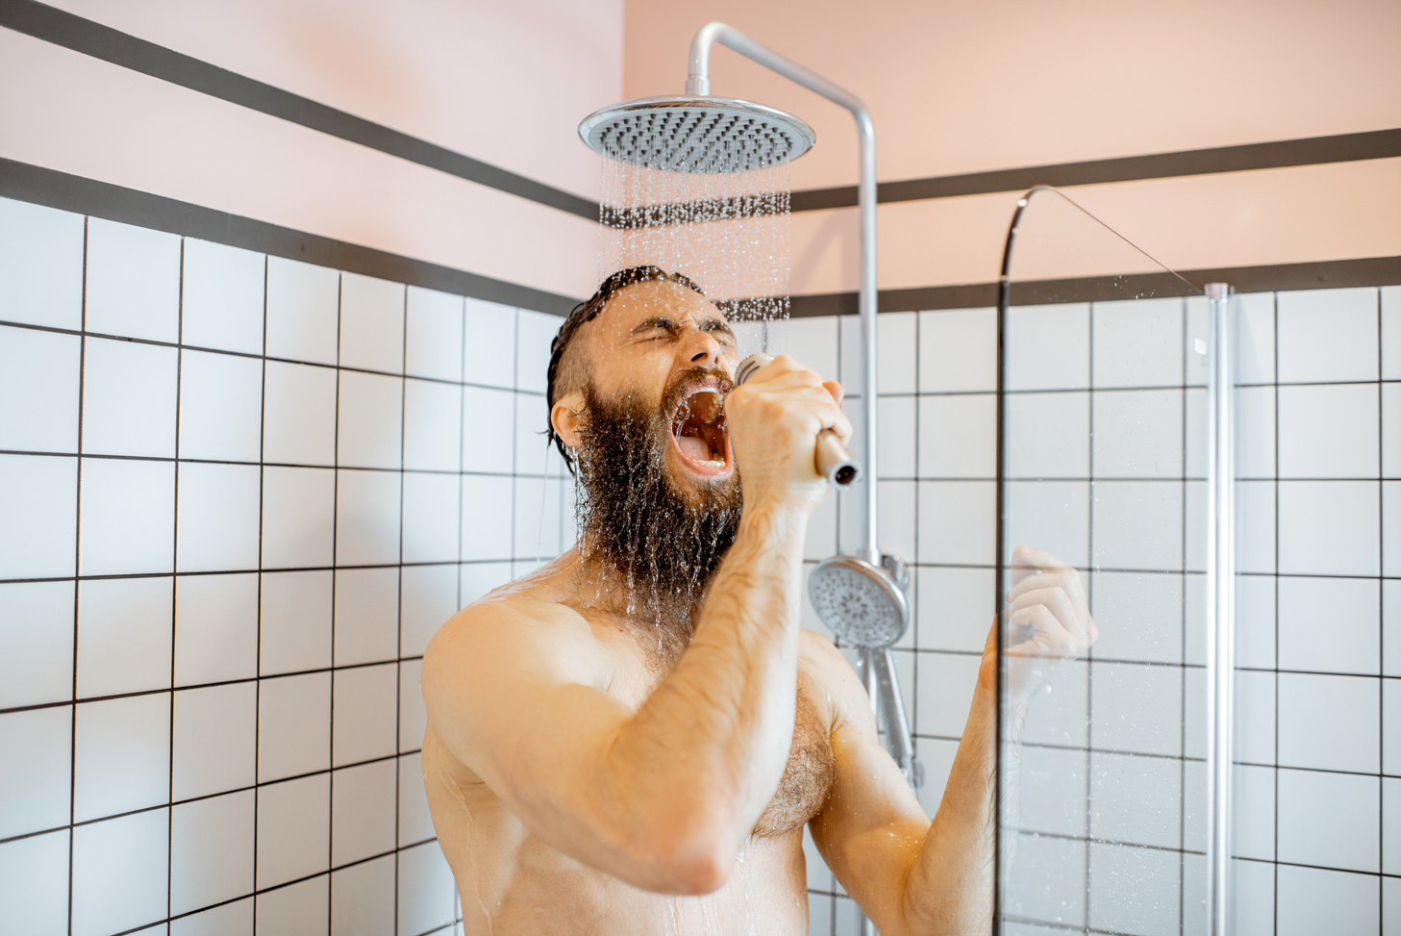
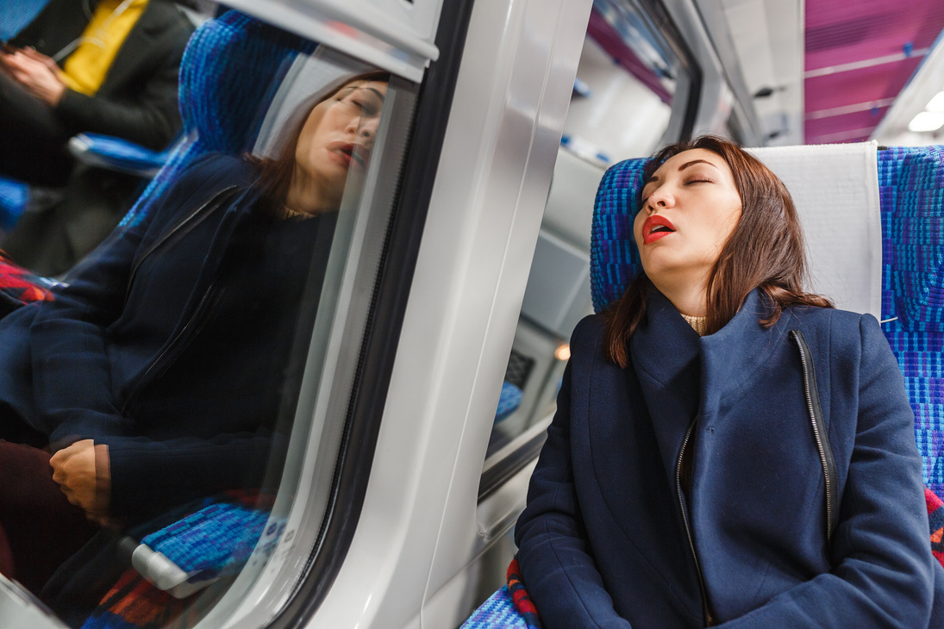
MY HOBBIES
Dancing
Singing
Travelling
1
2
3

Slide 4

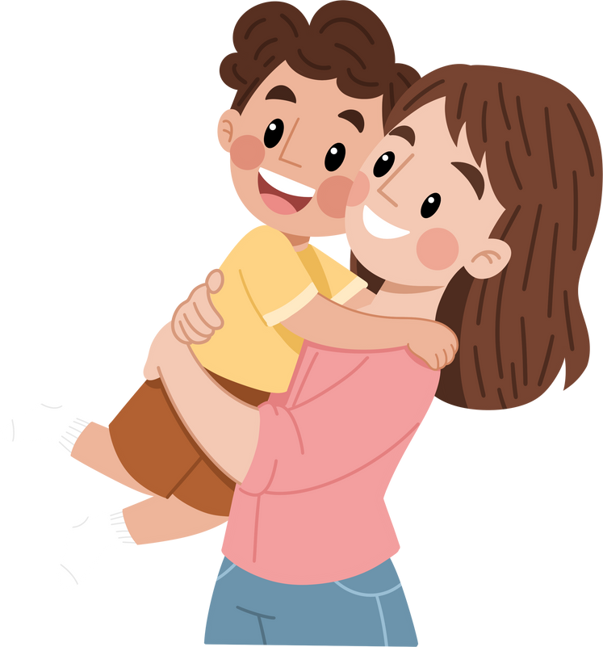
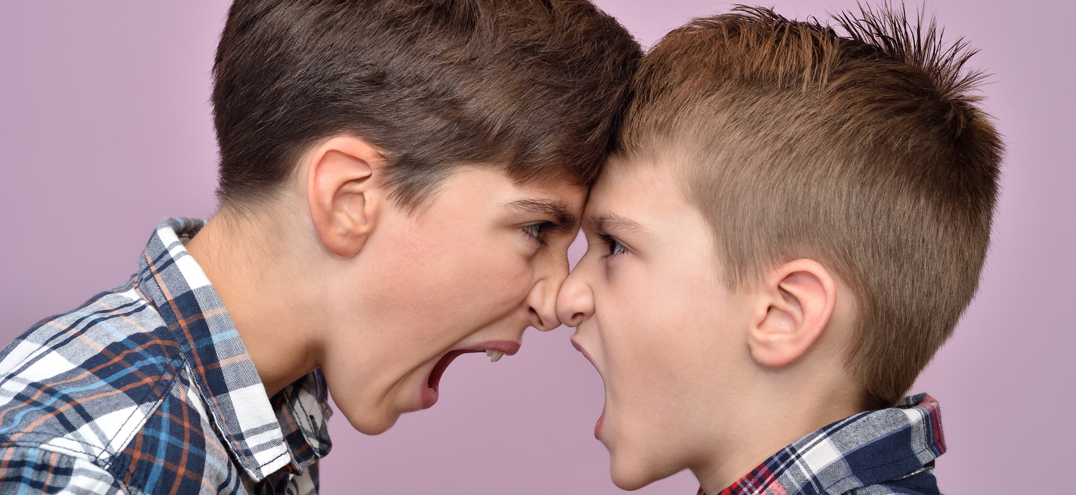

MEET
MY FAMILY
I live with my mom, dad, and my two brothers

Slide 5
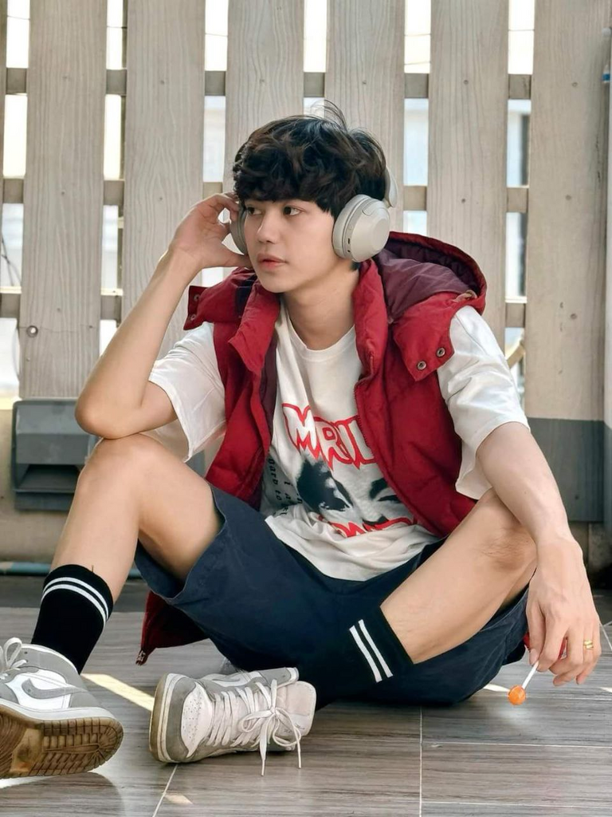


MEET
MY FRIEND
His name is Devon

Slide 6

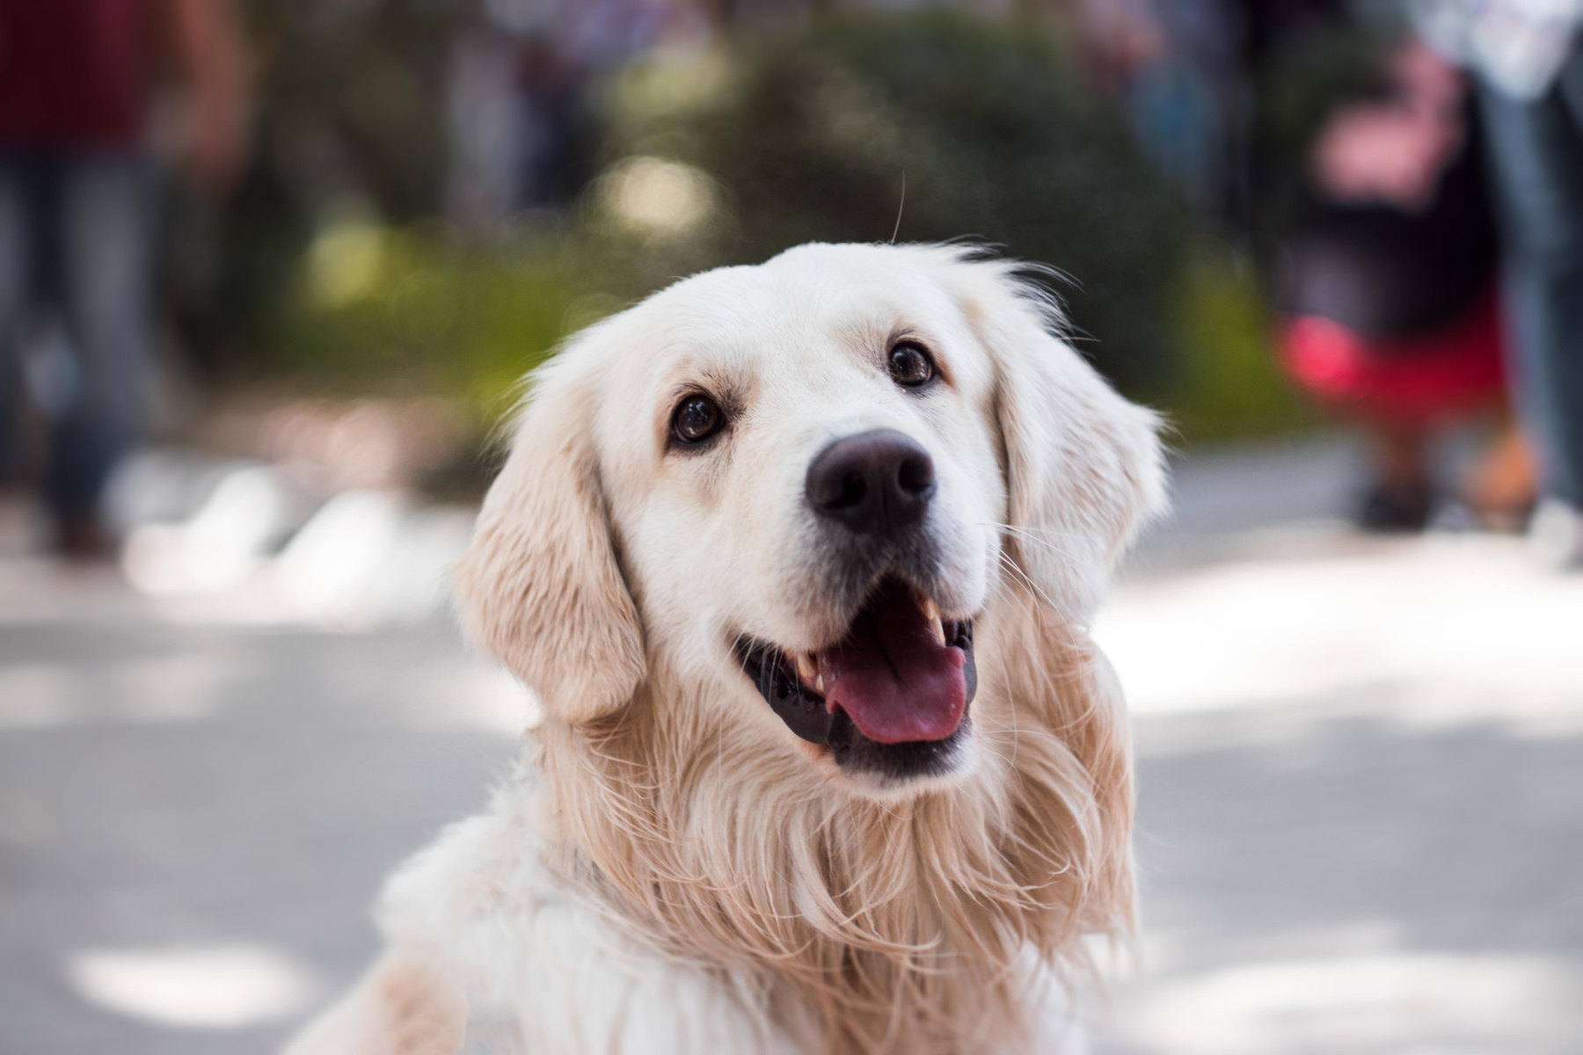
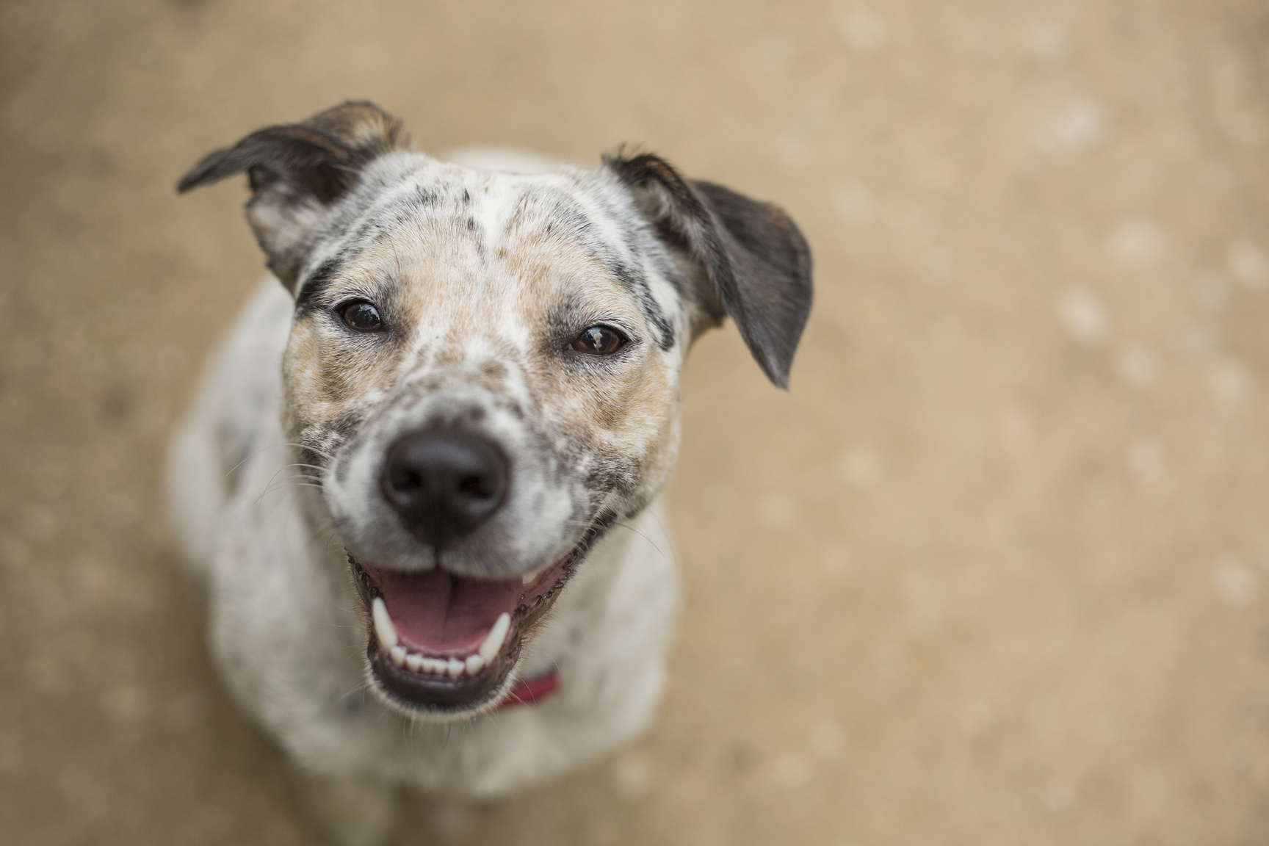
MEET
MY DREAM PETS
Rosco
Rebel

Slide 7


MY FAVORITE SUBJECT

Slide 8



MY HOPES
I hope to have a great school year and make honor roll in Teaching!
MY DREAMS
My dream is to be a best Teacher!

Slide 9


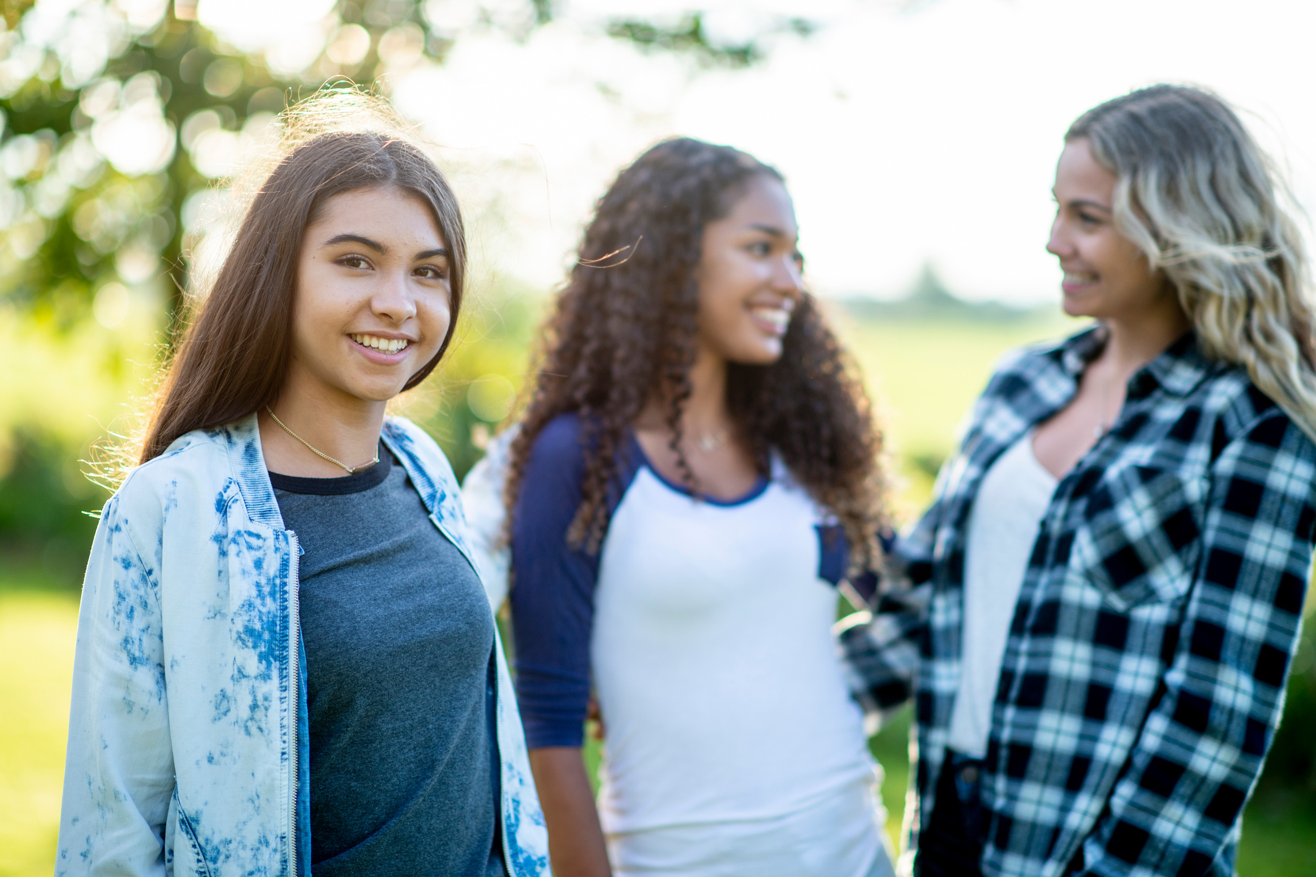
FUN FACTS ABOUT ME
Love to travel
Read horrors
Burger+ Pizza
Like to go to the movies
Singing

Slide 10
THANK YOU!

